Slide 1
The Reporting of Crash Data on Driver Distraction and Fatigue-What the literature reveals
Bill Frith, Opus International Consultants, Central Laboratories

Slide 2
Reporting and definitions of fatigue and distraction vary greatly around the developed world
Information sources identified were :
Information from Police reporting of crash factors
Information from in-depth studies
Surrogate measures (for fatigue)
Intermediate outcome measures (generally cellphone use)

Slide 3
Definitional issues
Fatigue: Reporting of this can vary from only reporting going to sleep at the wheel through various degrees of suspicion to various surrogate measures
Distraction: Considerable variation - Covered in depth by Craig.

Slide 4
Manner of Police Reporting
Many jurisdictions where Police report directly into the data-base use “click-boxes” to report factors.
This practice is controversial as on one hand it is simple and cheap and on the other hand it may lose potentially valuable detail from Police Officer text comments.

Slide 5
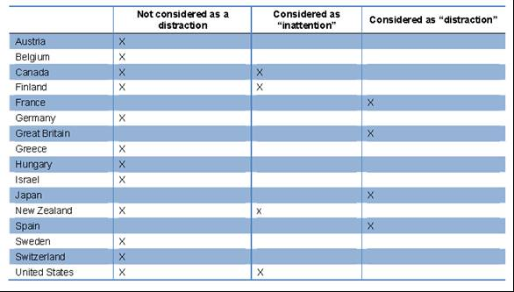
The special case of “emotional stress” - IRTAD survey results

Slide 6
Surrogate measures
“Surrogate measures” are measures used as substitutes for a direct measure when direct measures are hard or impossible to come by
There have been a lot of surrogate measures for fatigue proposed as fatigue is so difficult to measure directly
The use of surrogate measures is controversial

Slide 7
An example of a surrogate measure for fatigue
ATSB (2002) Involves a two step selection process:
First exclude:
all crashes involving a blood alcohol concentration (BAC) greater than 0.05g/100ml
all crashes involving any unlicensed drivers or unlicensed motorcycle riders
all crashes involving a pedestrian
all crashes where the speed limit is less than 80km/h
Then include:
all single vehicle crashes occurring between 12 a.m. - 6 a.m. and 2 p.m. – 4p.m.
all head on crashes where neither vehicle overtaking.
Identified 251 of 1,511 (16.6%) fatal crashes as “fatigue related”.

Slide 8
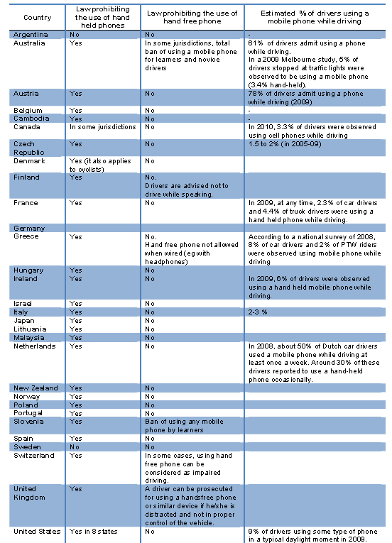
An Intermediate outcome measure – Cell phone use while driving- IRTAD survey – 2009

Slide 9
Surrogate measures tend to indicate higher levels of factor involvement than direct measures

Slide 10
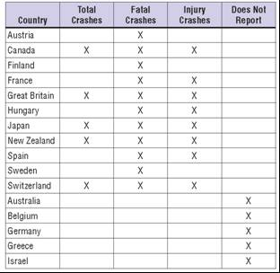
IRTAD survey of Police distraction reporting

Slide 11
Traditional in-depth studies
These vary in scope, and include:
Police, motor manufacturer and insurance company serious crash investigations
Multidisciplinary on-the-spot studies
Multidisciplinary studies, with a time lag, of crashes taken from data-bases

Slide 12
The relevant factors are reported in in-depth studies in mainland Europe, the UK and North America
The main issues with in-depth studies are:
Cost both of data gathering and analysis
Analysis protocols can be complex and hard to understand
Timeliness in terms of site visits
Still a self-report component in conclusions
Some studies are of a propriety nature
They do not necessarily provide results which are very different from cheaper Police Reporting

Slide 13
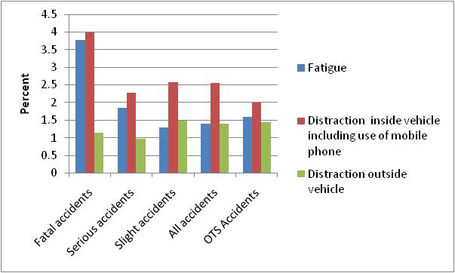
British Police Reporting (Stats19) vs “On -the –spot” study
Percentage of accidents in which certain factors are cited for UK Stats 19 accidents (2009) and OTS accidents

Slide 14
Cohort studies using naturalistic measurement of driver behaviour
An exciting new development-covered by other speakers

Slide 15
The end

